Slide 1
Finalizing the basics
Arafat Hassan

Slide 2
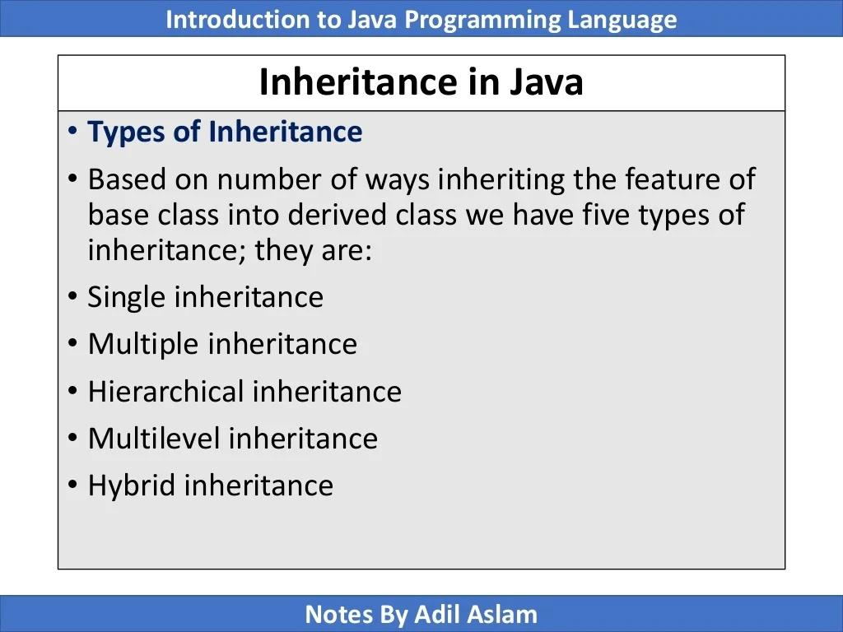

Slide 3
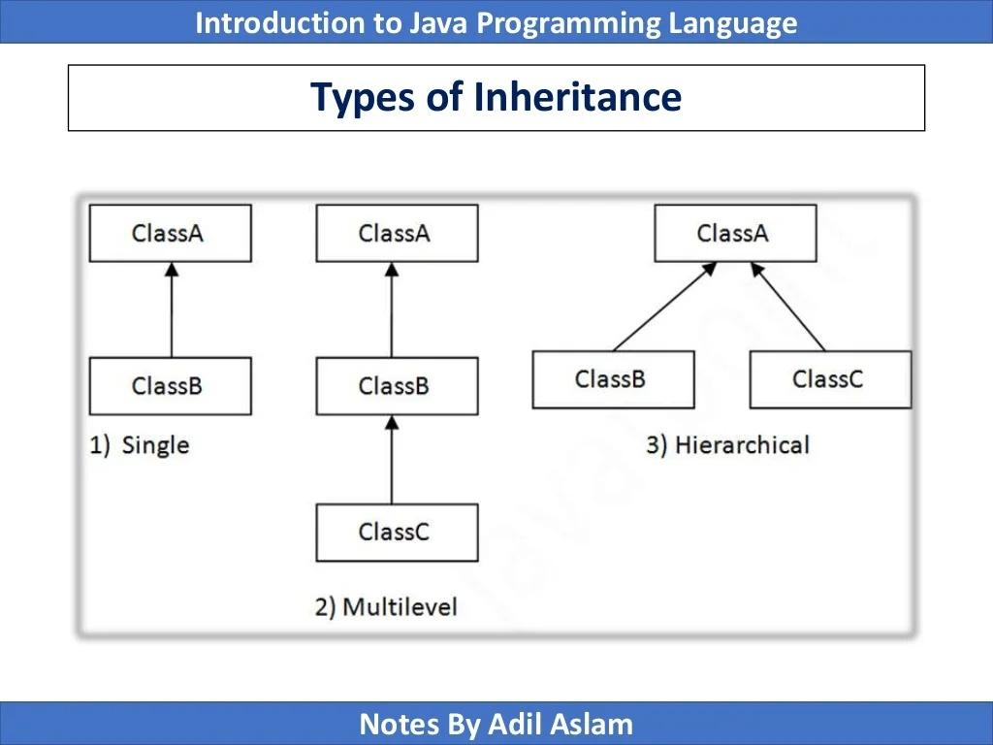

Slide 4
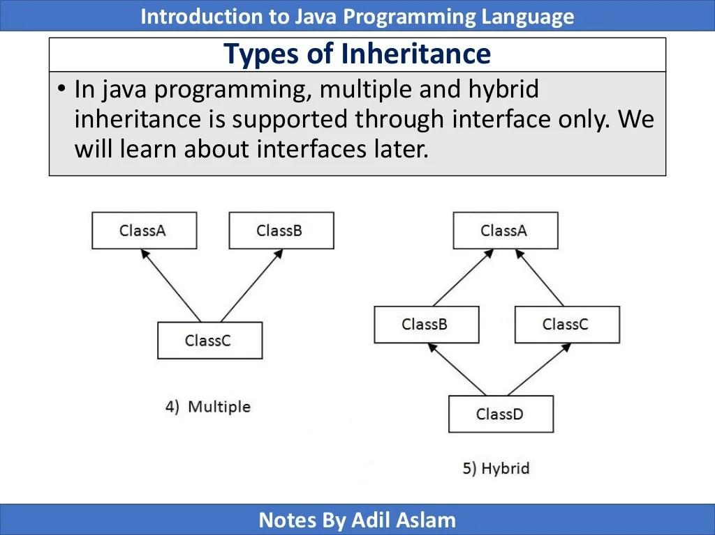

Slide 5
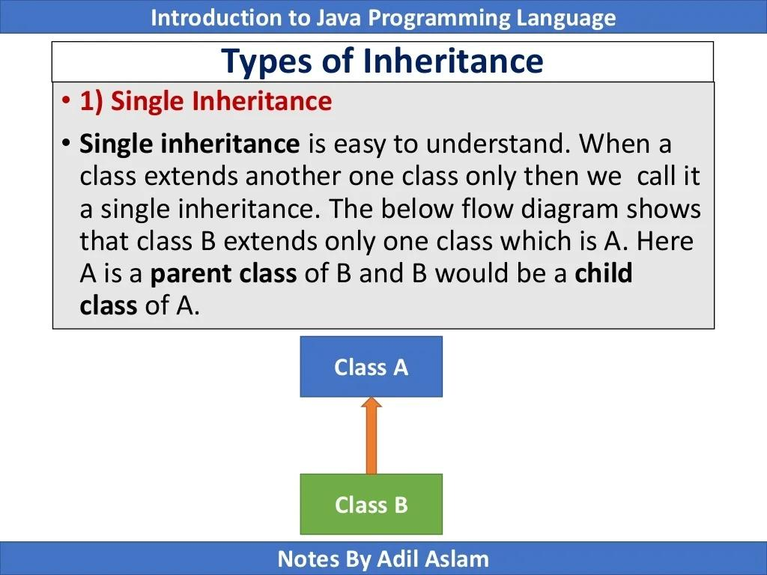

Slide 6
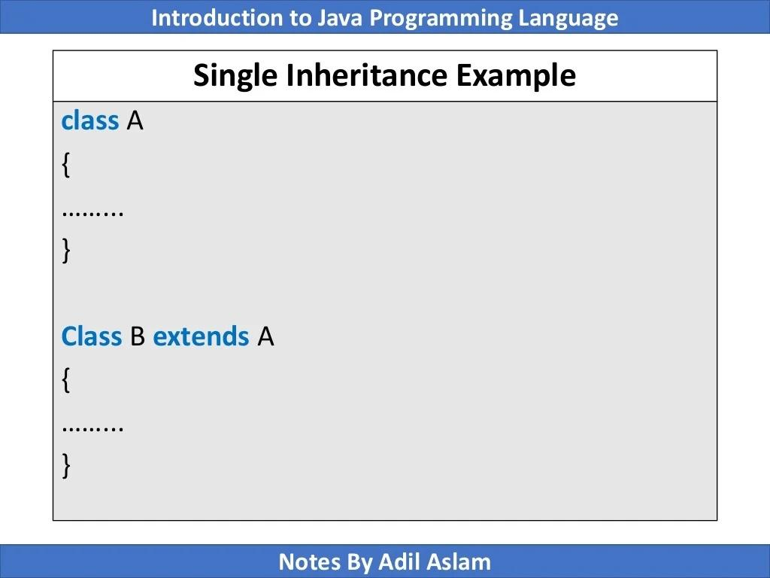

Slide 7
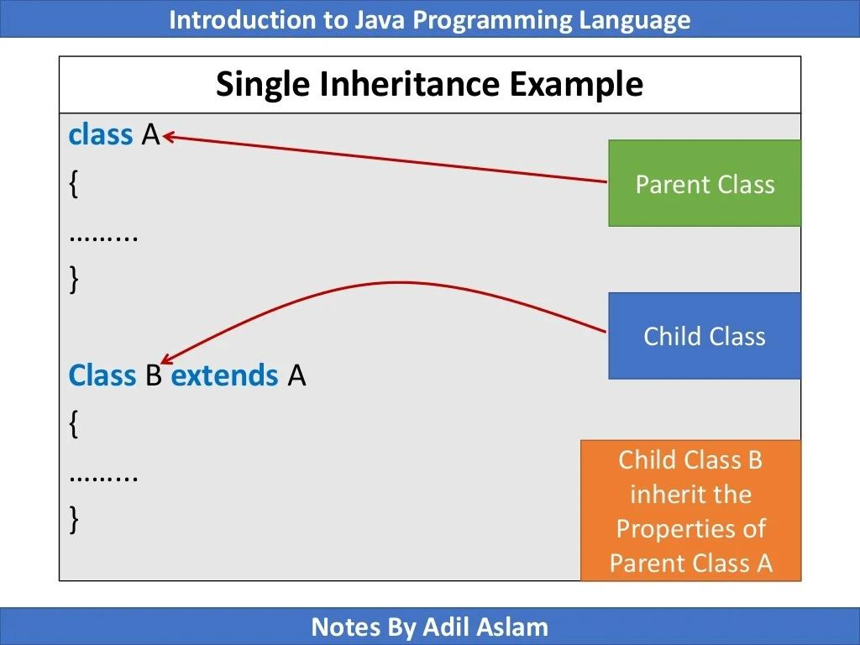

Slide 8
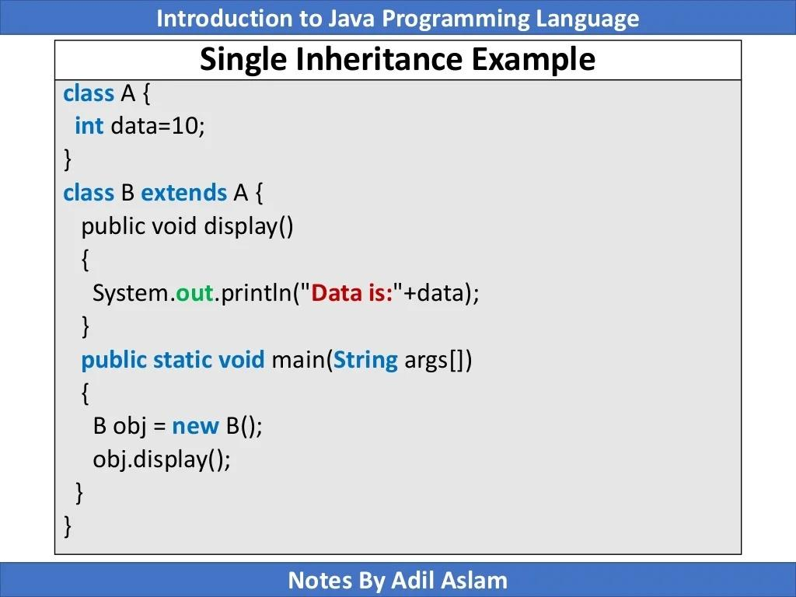

Slide 9
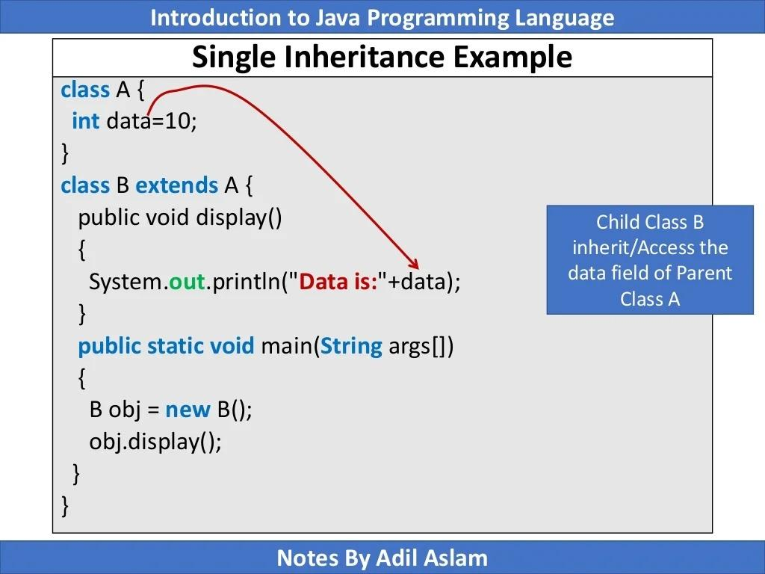

Slide 10
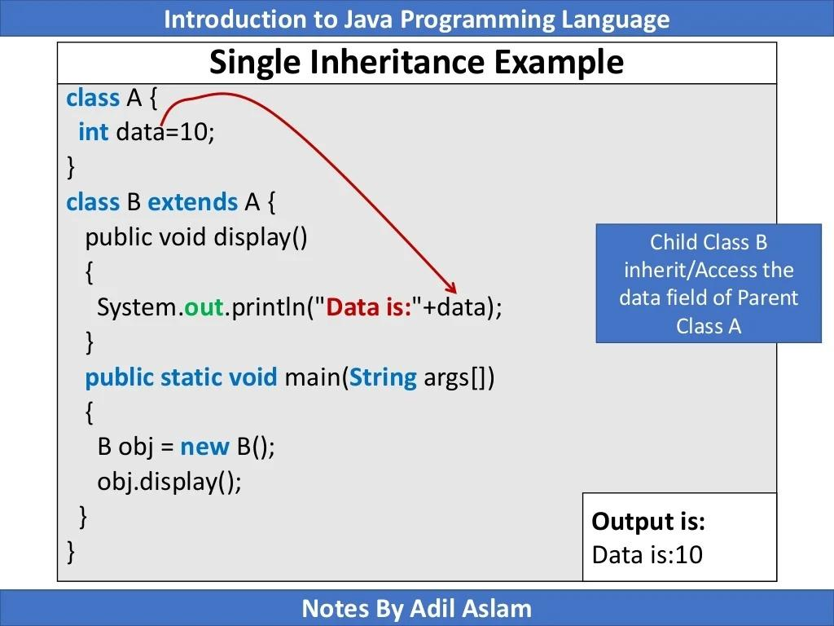

Slide 11
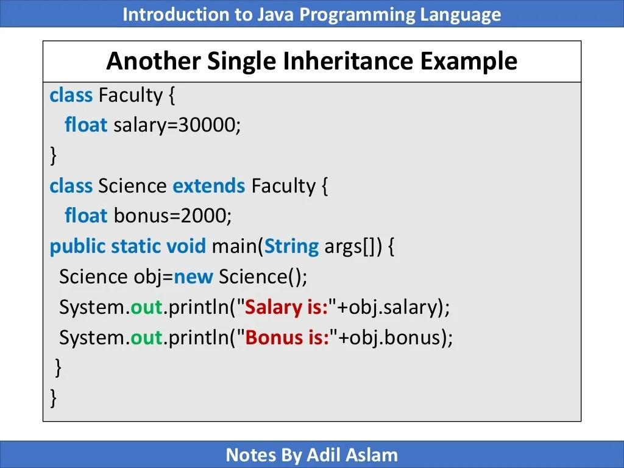

Slide 12
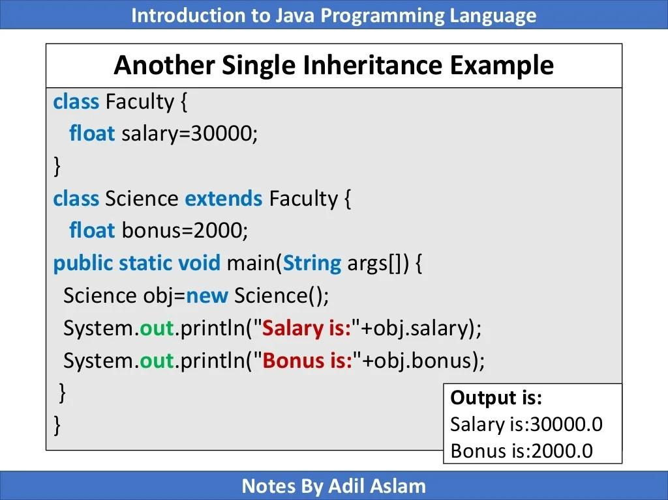

Slide 13
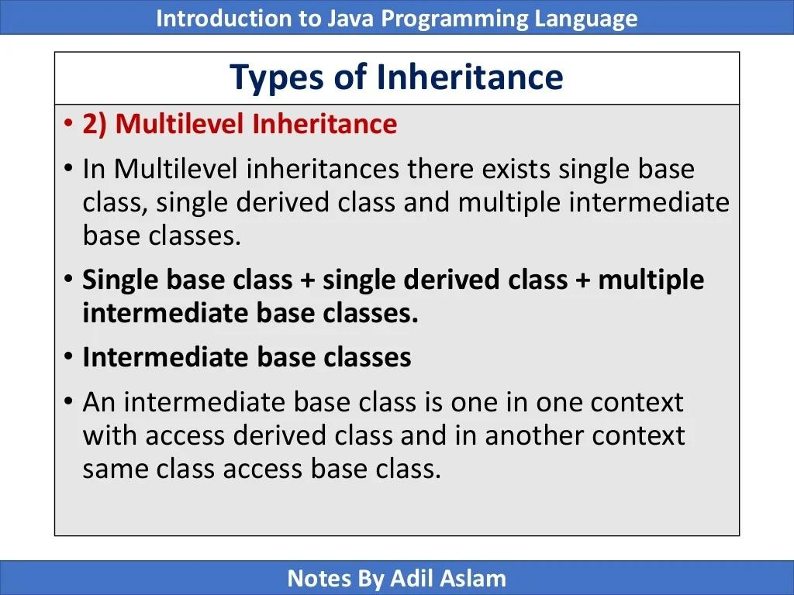

Slide 14
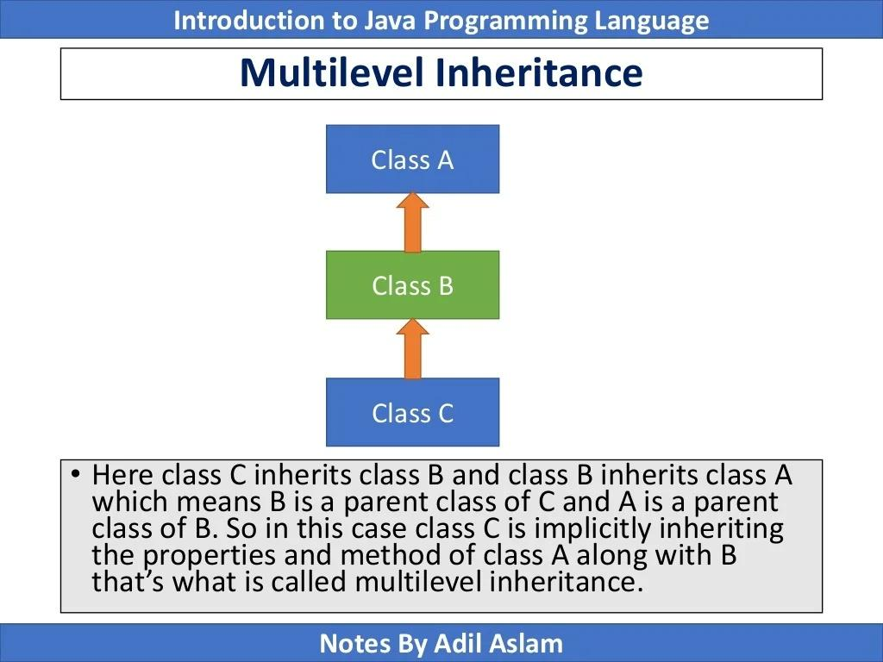

Slide 15
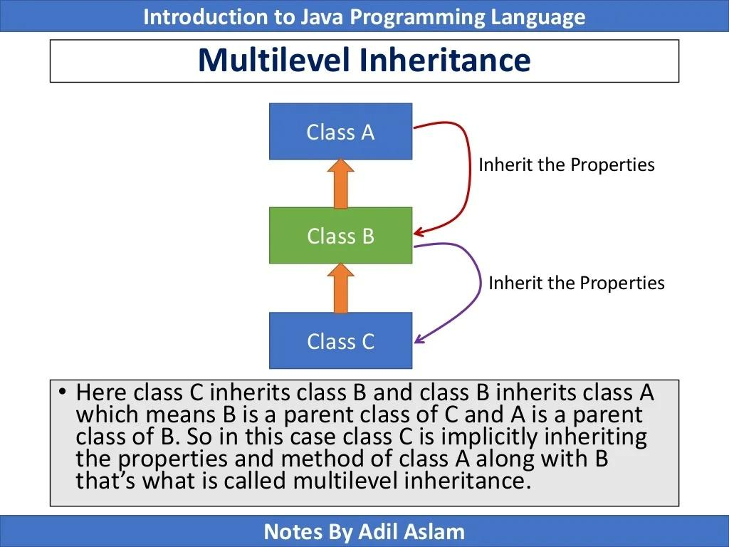

Slide 16
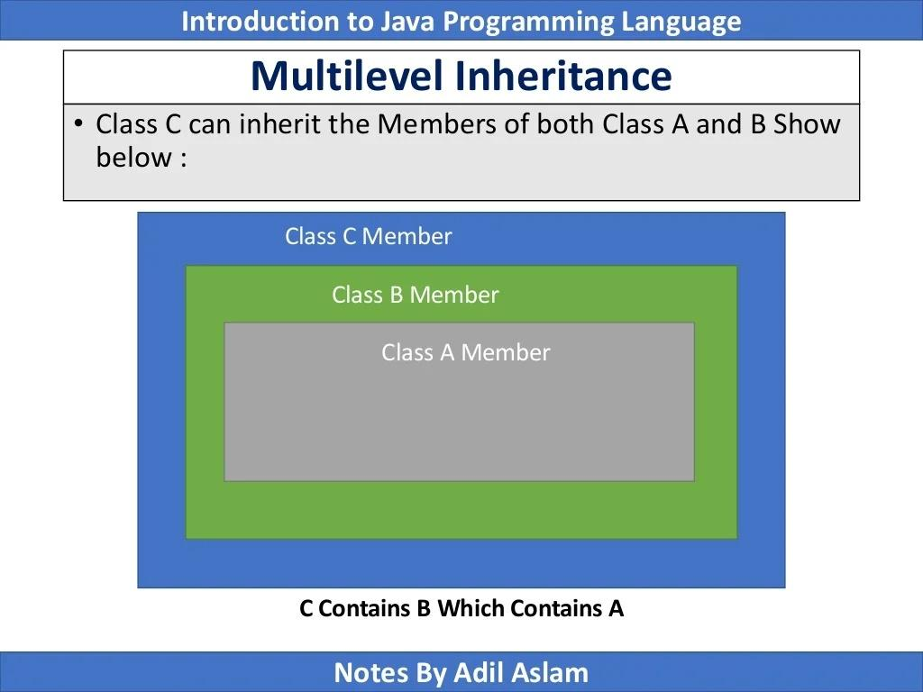

Slide 17
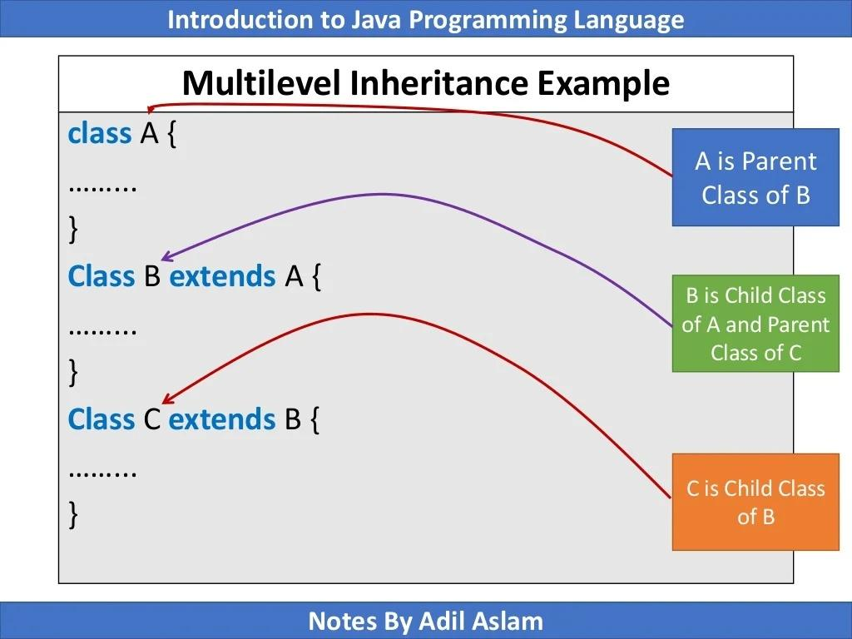

Slide 18
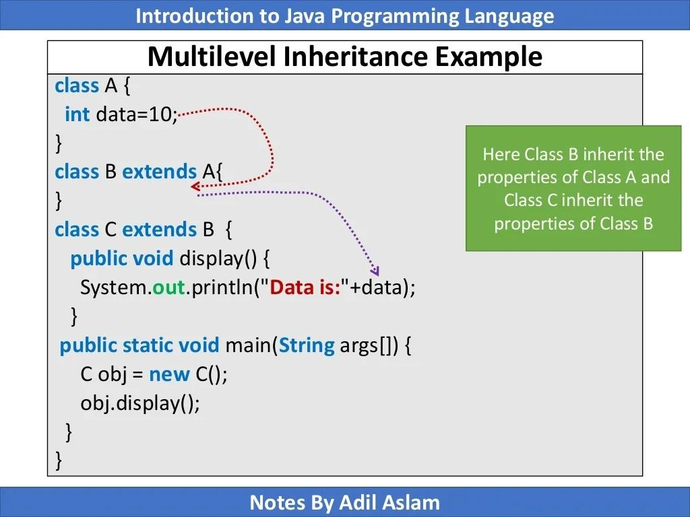

Slide 19
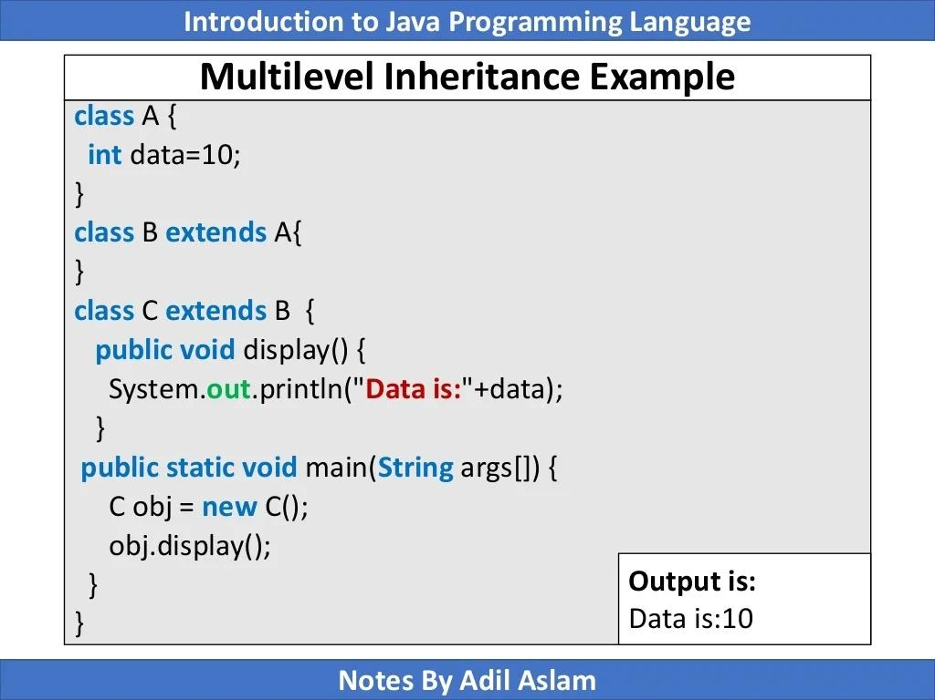

Slide 20
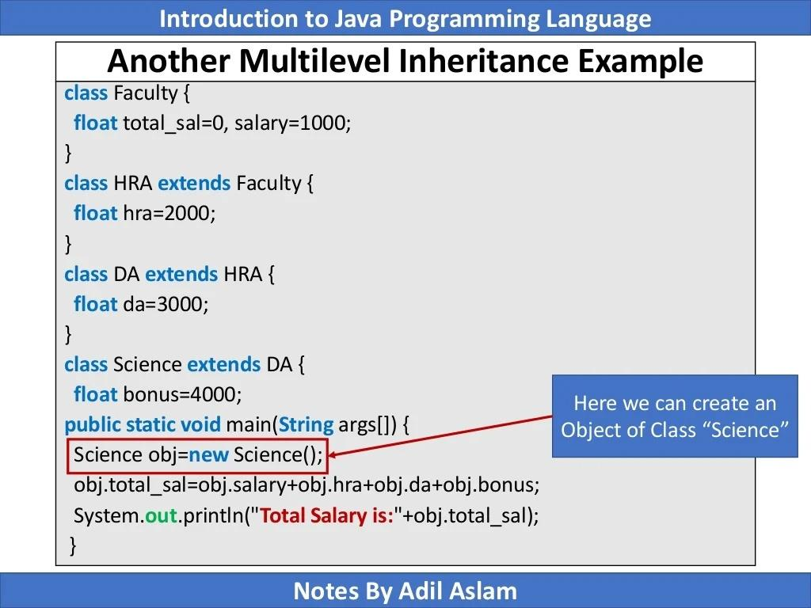

Slide 21
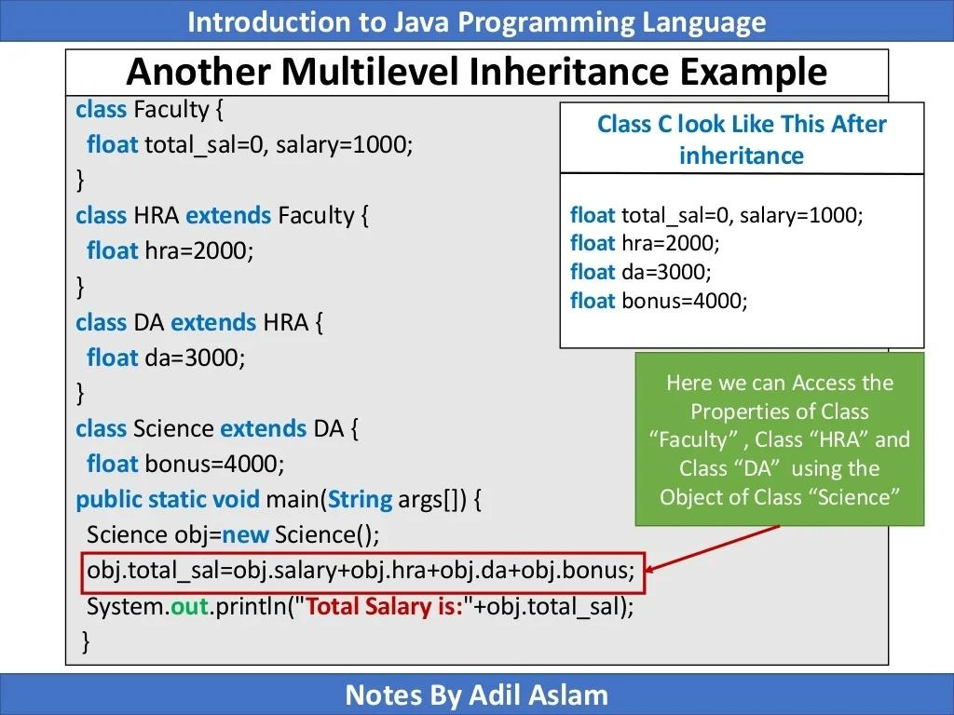

Slide 22
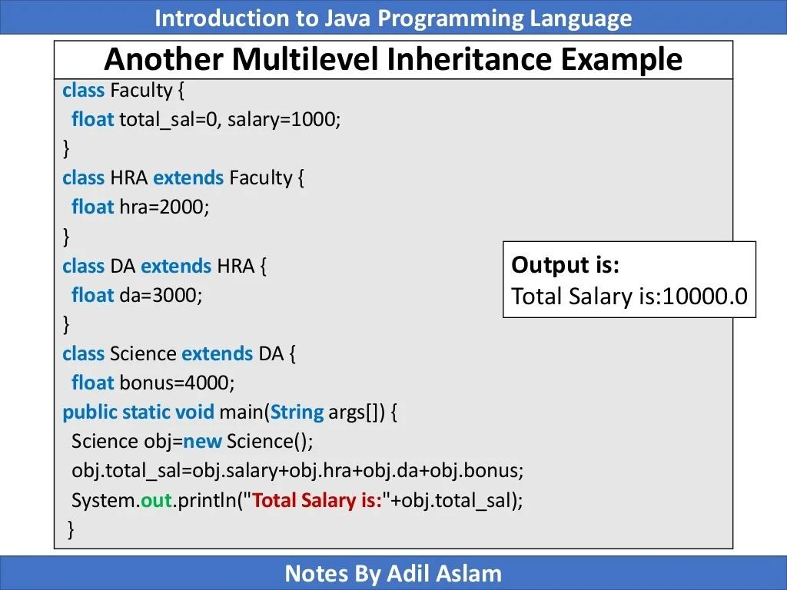

Slide 23
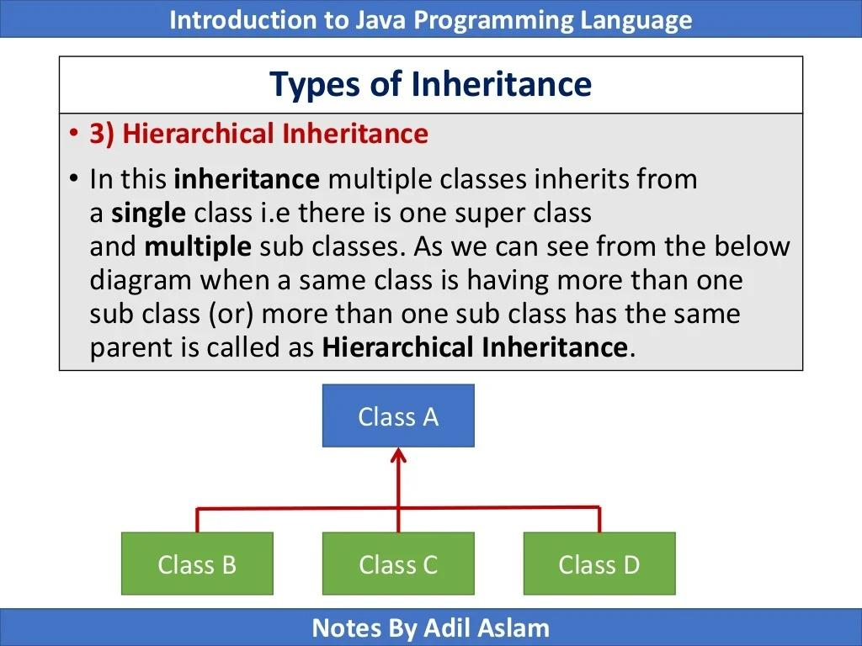

Slide 24
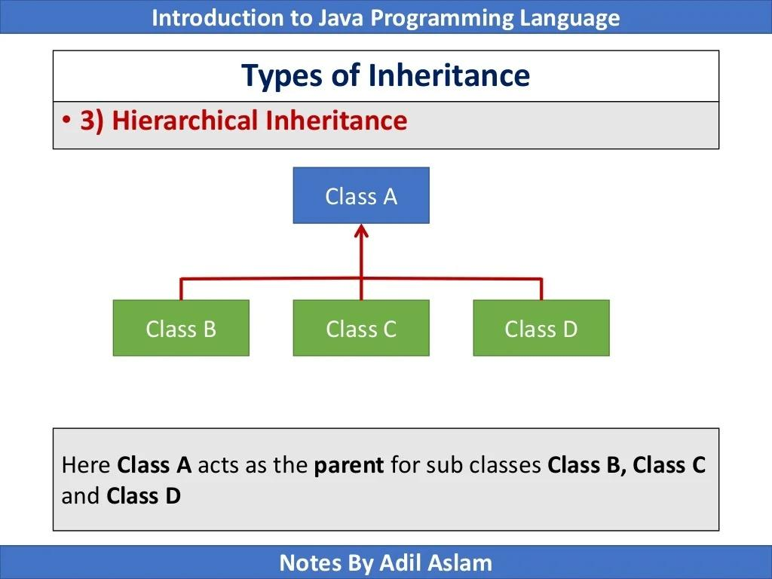

Slide 25
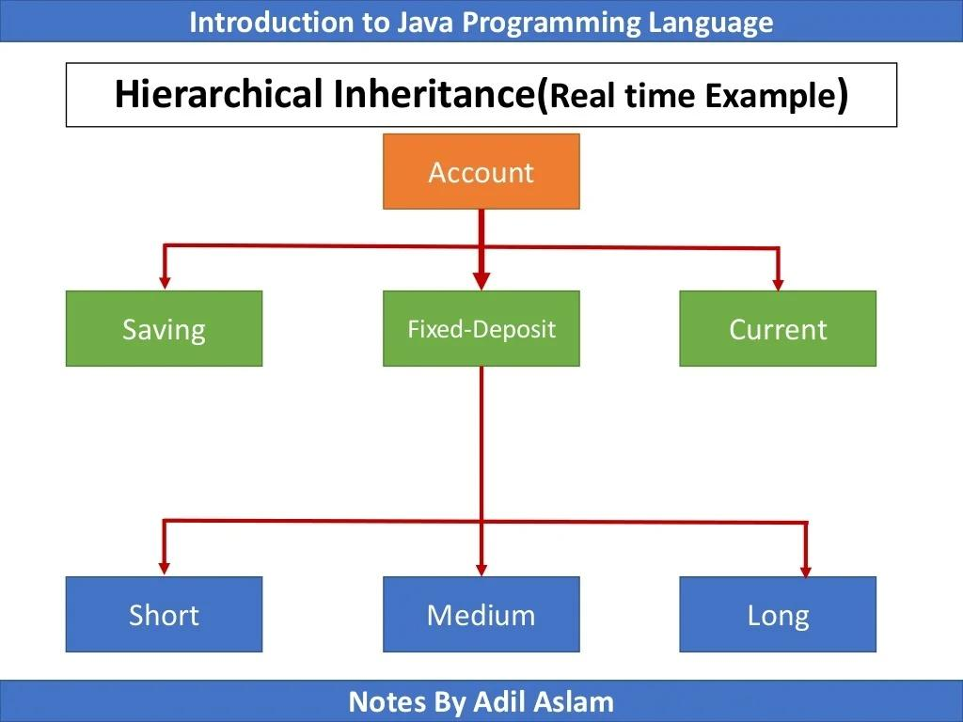

Slide 26
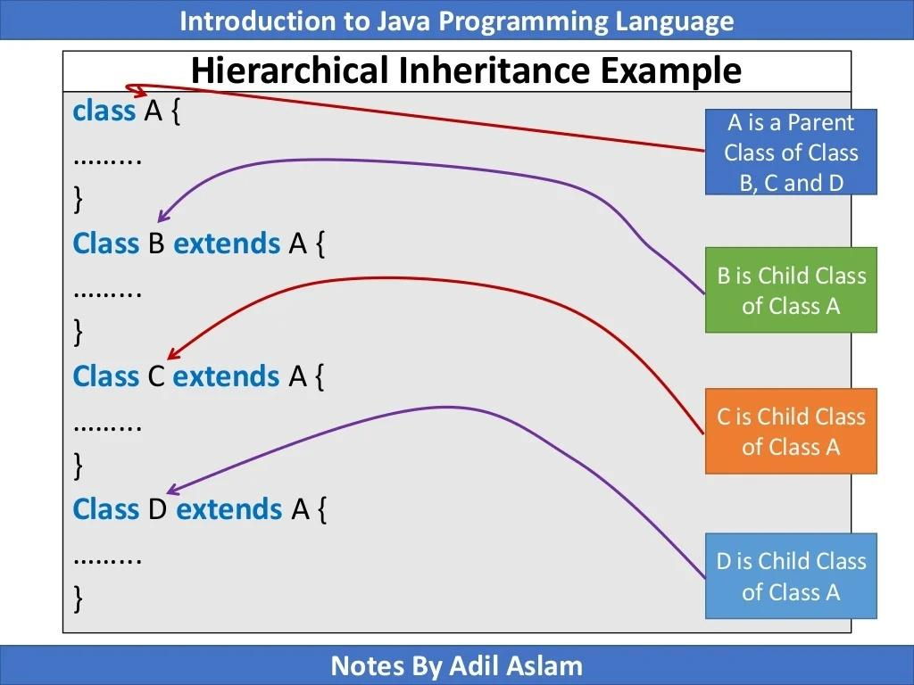

Slide 27
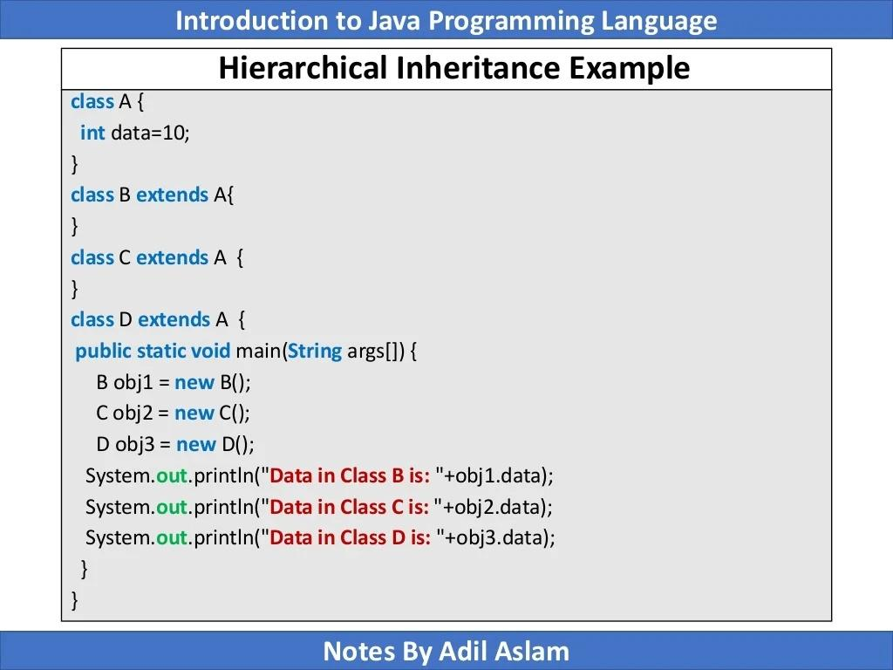

Slide 28
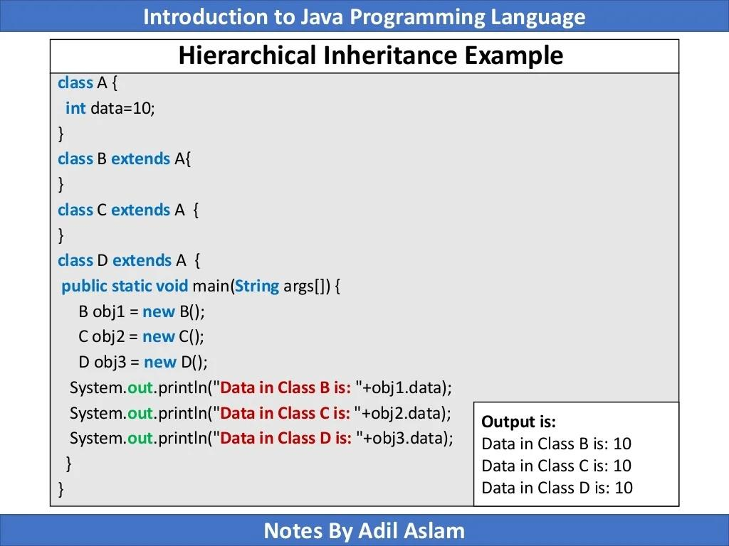

Slide 29
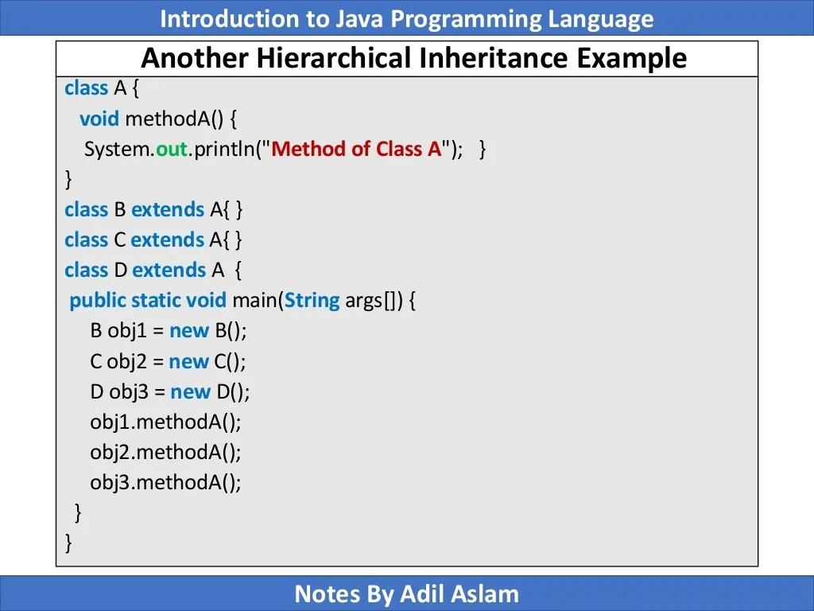

Slide 30
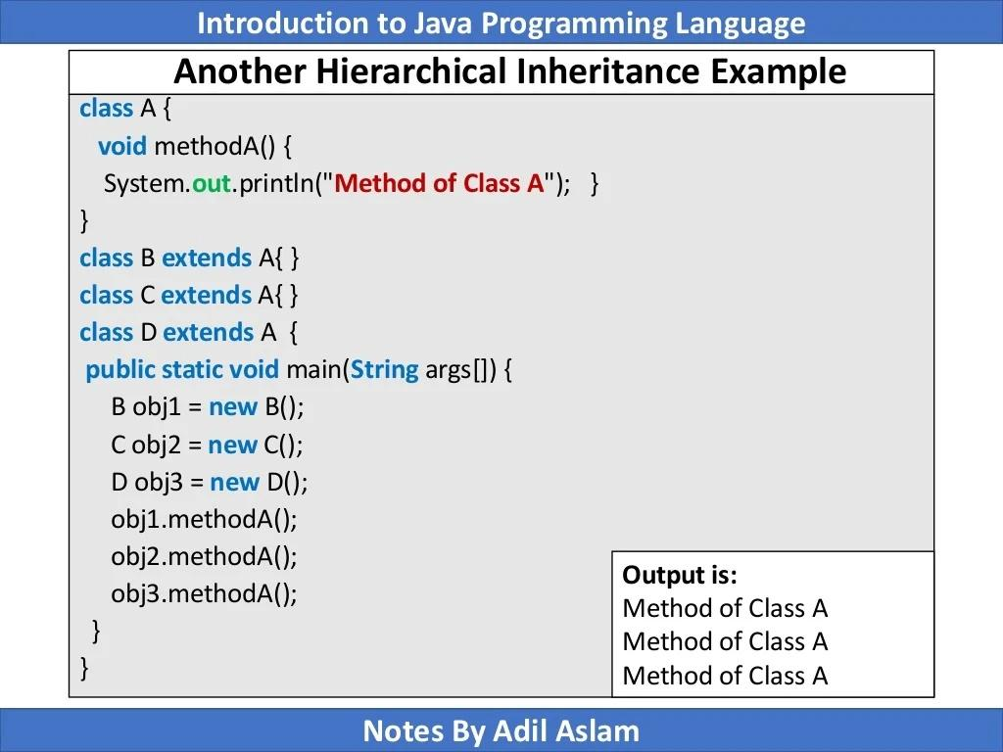

Slide 31
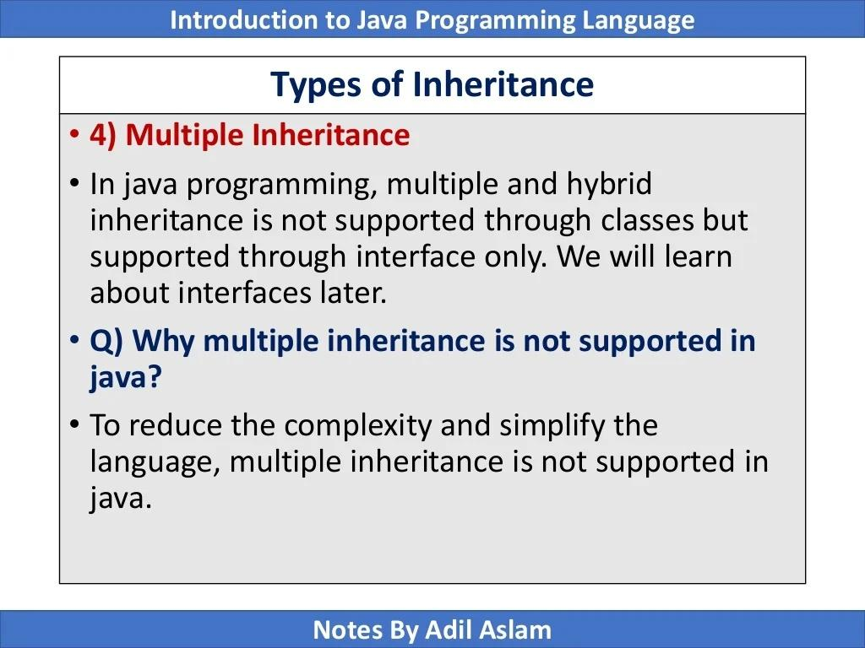

Slide 32
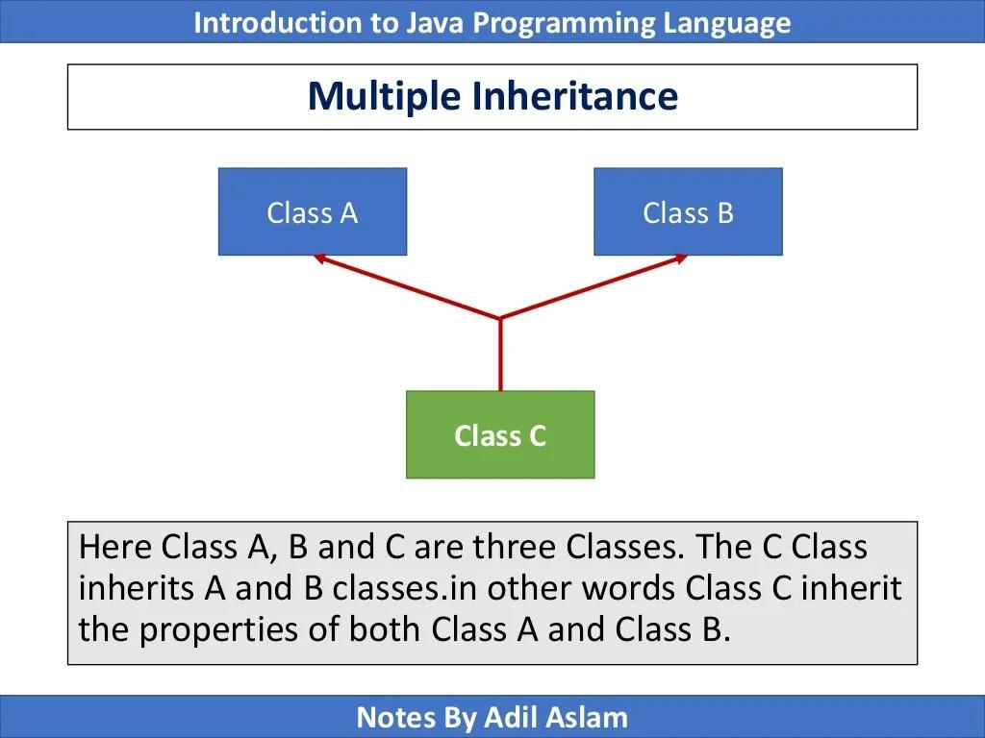

Slide 33
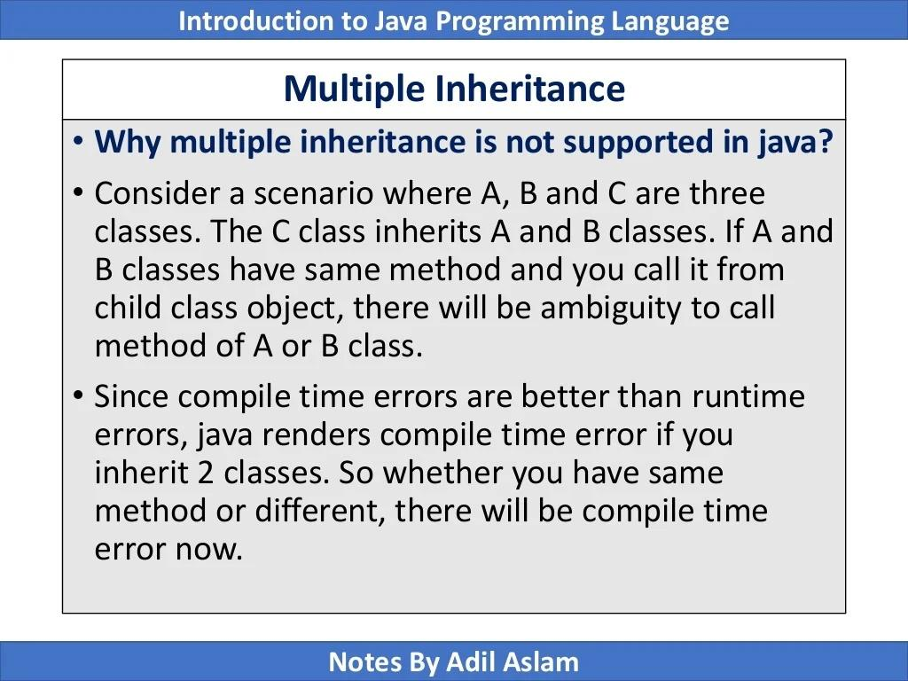

Slide 34
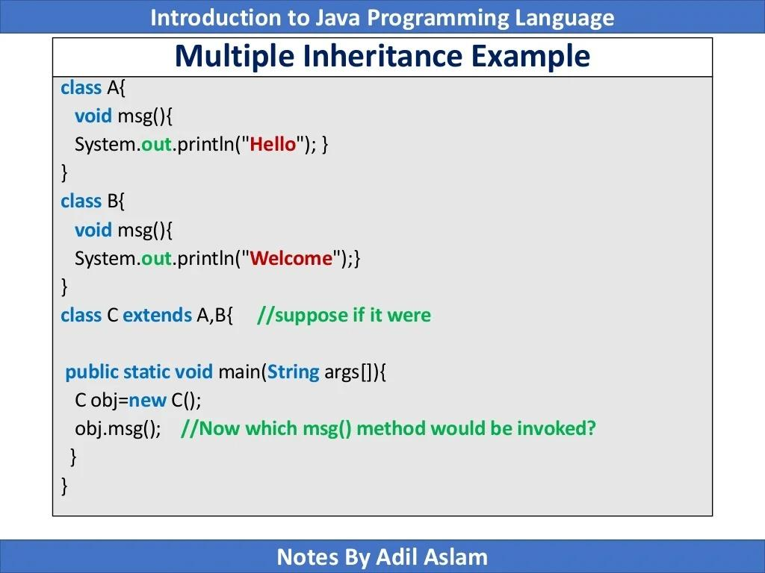

Slide 35
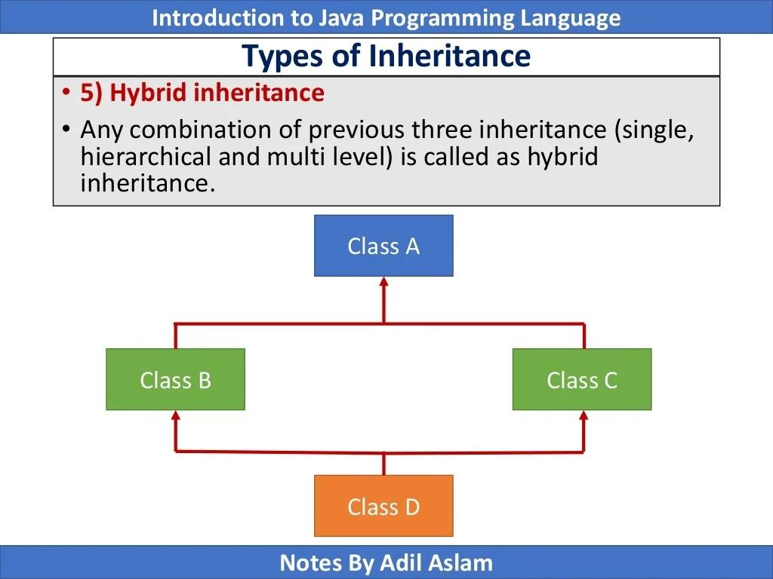

Slide 36
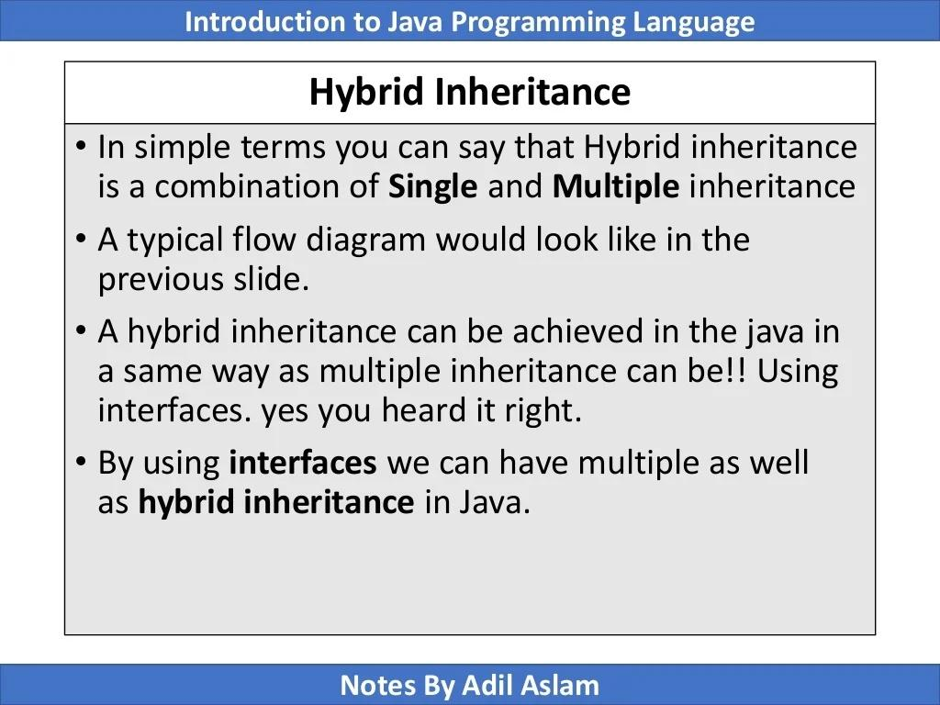

Slide 37
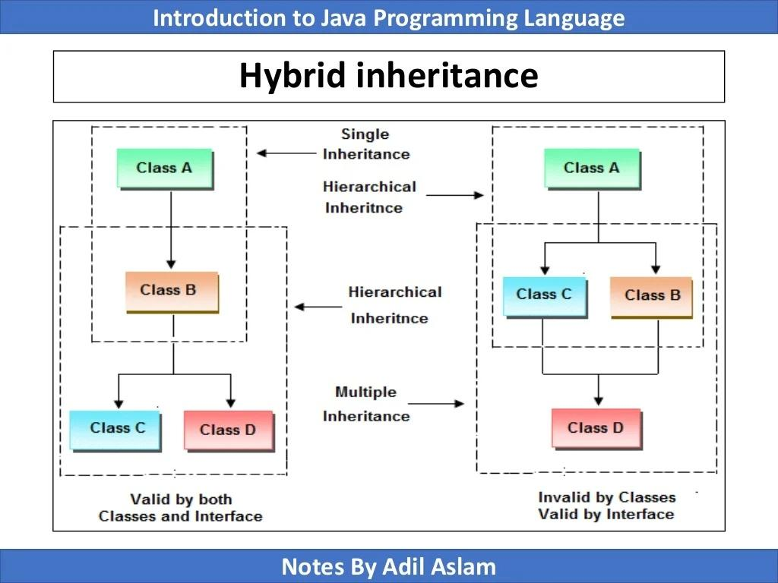

Slide 38
Dynamic method dispatch

Slide 39
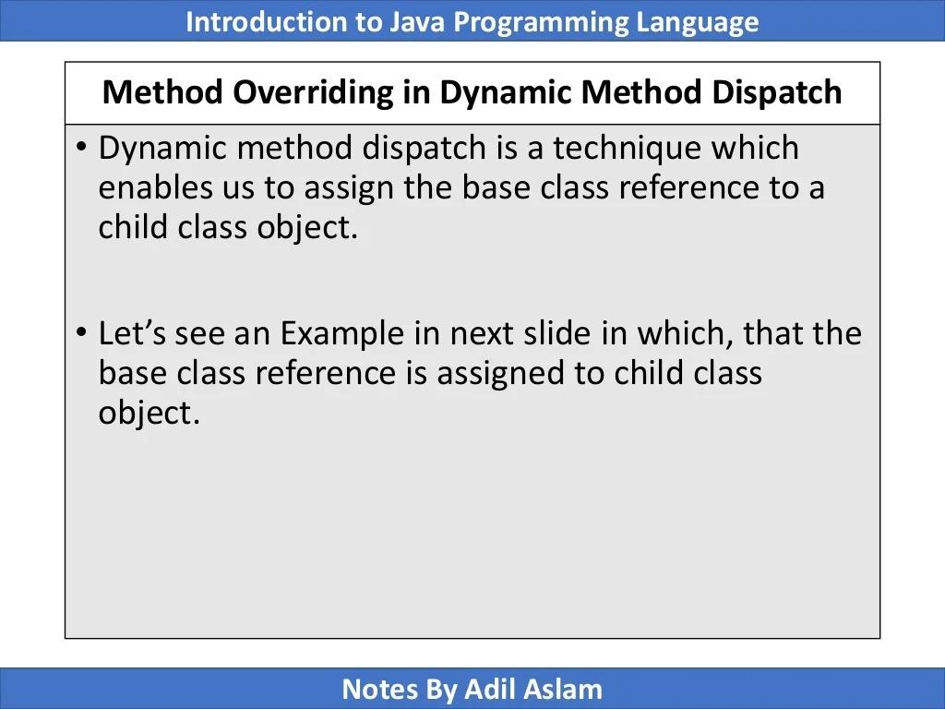

Slide 40
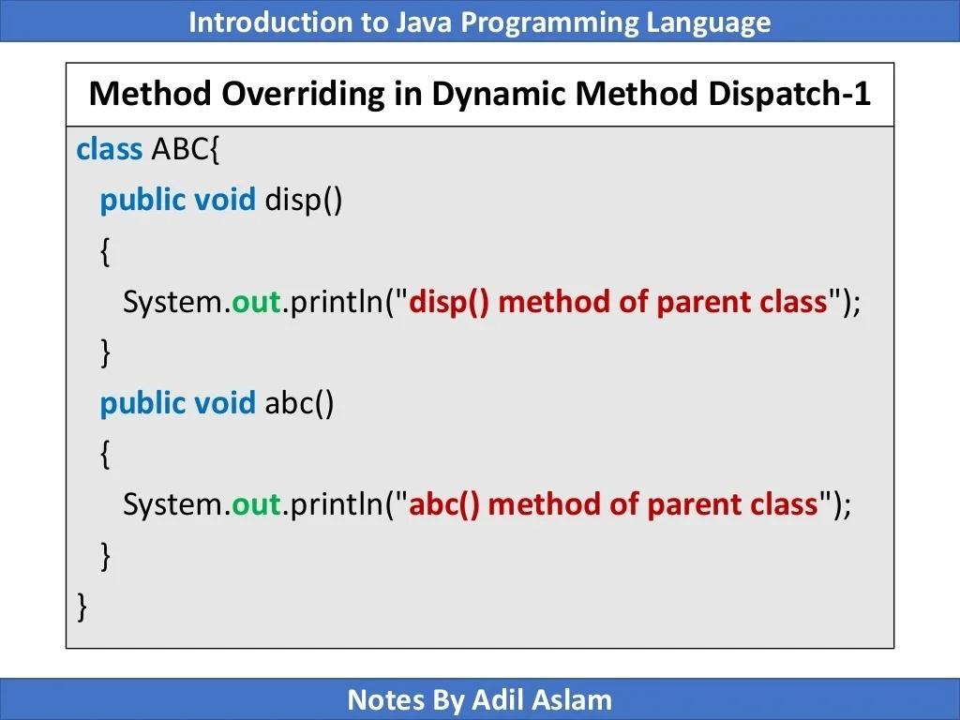

Slide 41
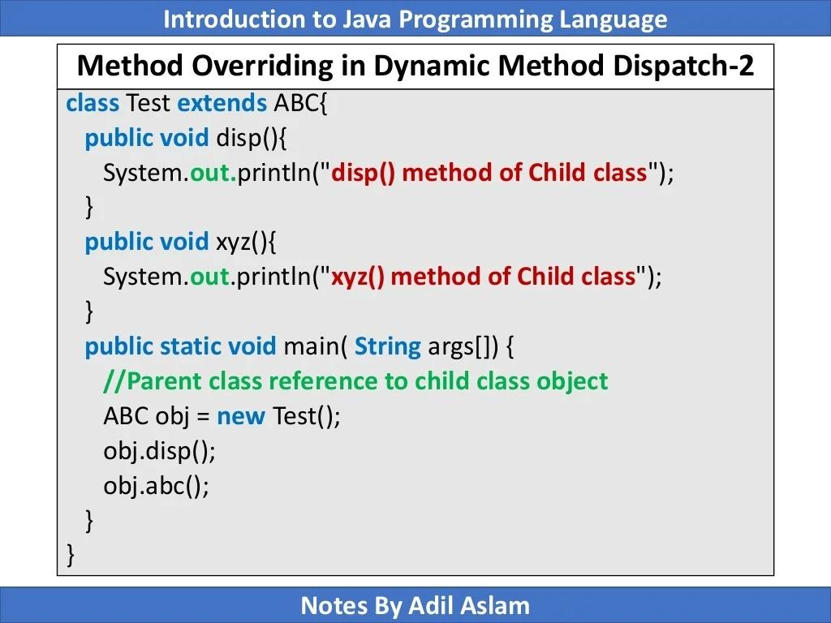

Slide 42
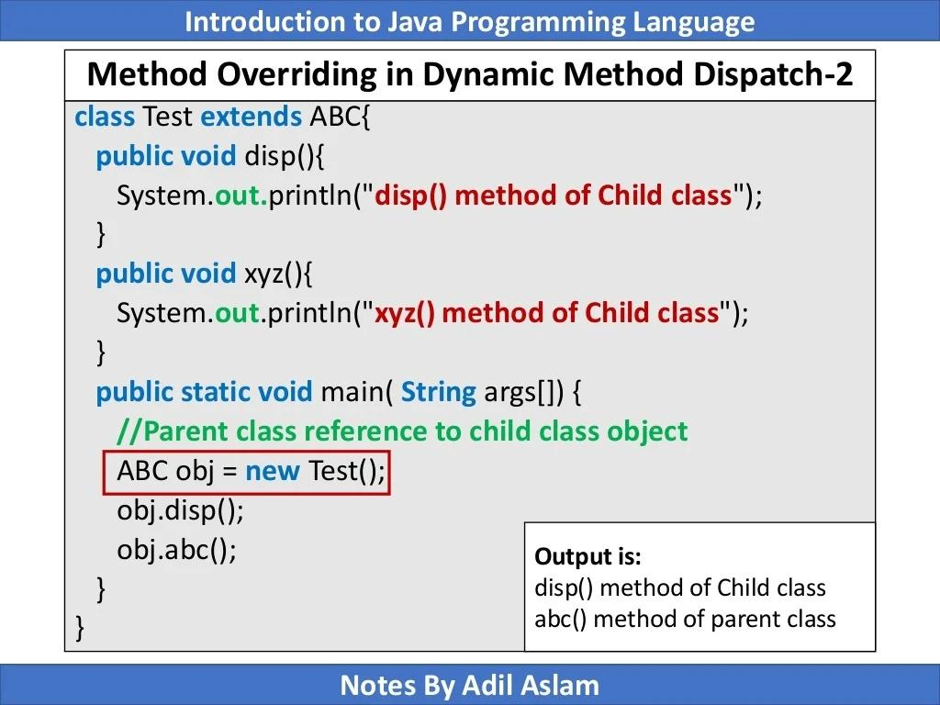

Slide 43
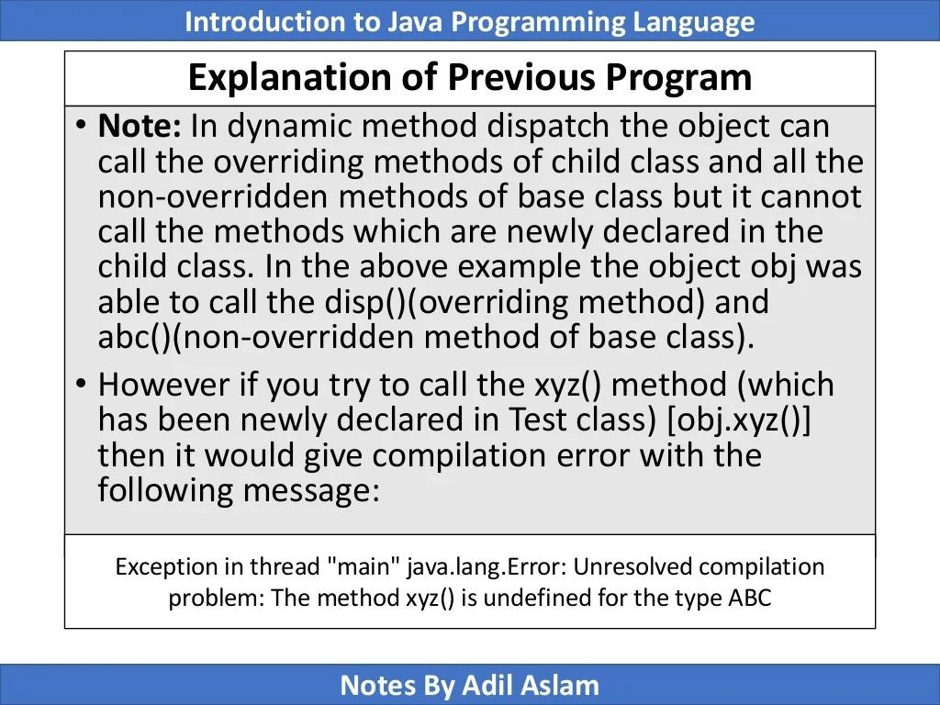

Slide 44
Exception handling

Slide 45
Exception handling
When executing Java code, different errors can occur: coding errors, errors due to wrong input, or other unforeseeable things.
When an error occurs, Java will normally stop and generate an error message. The technical term for this is: Java will throw an exception (throw an error).

Slide 46
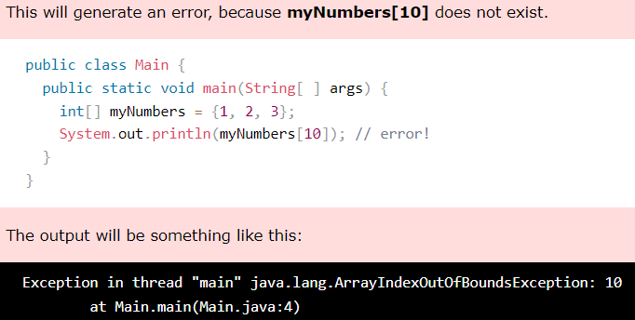
Exception handling

Slide 47
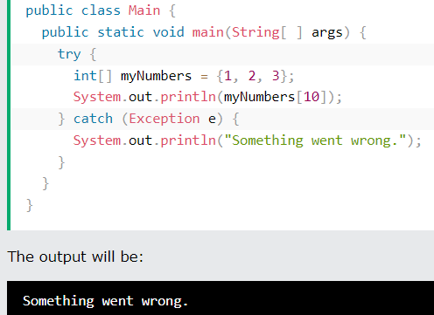
Exception handling
If an error occurs, we can use try...catch to catch the error and execute some code to handle it:

Slide 48
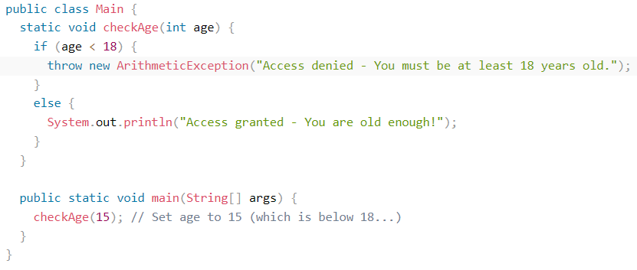
Exception handling
The throw statement allows you to create a custom error.

Slide 49

Exception handling
Output when age < 18:
Output when age >= 18:

Slide 50
Exercises

Slide 51
Exercises
Make a random number generator in Java
Make a rock paper scissors game. The program will take input from the console and compare the input will a randomly generated computer choice. It will show whether the player has won or lost, and keep a count of his or her score.
Write a Java program to break an integer into a sequence of individual digits.
Input: 123456
Expected Output : 1 2 3 4 5 6
Write a Java program that accepts two integers from the user and then prints the sum, the difference, the product, the average, the distance (the difference between integer), the maximum of the two integers, and the minimum.

Slide 52
Exercises
Make a random number generator in Java
Make a rock paper scissors game. The program will take input from the console and compare the input will a randomly generated computer choice. It will show whether the player has won or lost, and keep a count of his or her score.
Write a Java program to break an integer into a sequence of individual digits.
Input: 123456
Expected Output : 1 2 3 4 5 6
Write a Java program that accepts two integers from the user and then prints the sum, the difference, the product, the average, the distance (the difference between integer), the maximum of the two integers, and the minimum.

Slide 53
Exercises
Java Method exercises and solution - w3resource
Write a simple calculator program in Java. The user is presented with the option to add, subtract, multiply, and divide.
For division, be sure to take care of division by zero by exception handling.
Also for every division, give three outputs - the accurate answer, answer rounded to 2 decimal places, rounded to the nearest to the nearest integer, and truncated to the nearest integer.

Slide 54
Exercises
Search for upcasting and downcasting in Java. Write a short explanation of
What you understand by upcasting and downcasting
How upcasting and downcasting relates to a) type casting and b) Dynamic method dispatch
What is polymorphism in Java? Give examples of compile time and runtime polymorphism. The example should make sense in real world. I.e., it must not be about hypothetical class “A” and class “B”. Rather it should be about meaningful class like Person class and student class.

Slide 55
Exercises
What are exceptions in Java? Show some examples where exceptions may arise. How will you handle these exceptions? Give examples with runnable code.
Give an example of how runtime exception may arise from careless type casting.

Slide 56
